Slide 1

Assistive technology law
National university Spd 653 cloudia Pawluk 2019

Slide 2
overview
For students with disabilities: Federal and State Legislation related to the provision and expected inclusion of Assistive Technology – known as AT and read as “A – T”
Expected inclusion of AT for students

Slide 3


BINARY BREAKDOWN
ASSISTIVE TECH DEVICE: 0
ASSISTIVE TECH SERVICE:1
Any service that directly assists a child with a disability
Selection, acquisition, or use of any service or technology
SEC 602.Definitions 20 USC 1401 P.L. 108-446, December 3, 2004.
Federal Law divides the definition of assistive tech into 2 component parts, which coincidentally the binary code has two parts, off/on, or 0/1
AT Device: ANY item or piece of equipment

Slide 4
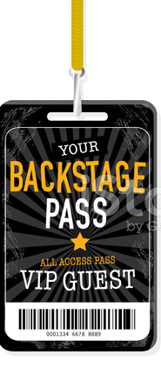
“Access to” : Tech Requirements. P.l. 108-446 in idea of 2004
Network
Satellite
Link
A WAY OF LOOKING AT PROBLEMS AND OFFERING SOLUTIONS
- (2018) BUGAJ, CHAPTER 1
An IEP team creates a plan whether a child requires AT device or service. AT – as defined within the term “supplementary aids and services” in both IDEA Individuals with Disabilities Education Act and 504: 1992, 1998, Section 504 of the Rehabilitation Act. (ldrfa.org)

Slide 5
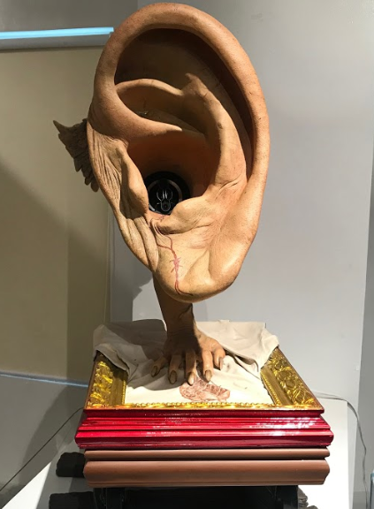
Examples of items that are not assistive tech
(author’s IMAGE of display) ILOILO MUSUEM OF CONTEMPORARY ART
MEDICAL DEVICE: Assistive Technology does not include any device that is surgically implanted or the replacement of such a device, such as a hearing aid or implant.
SEC. 602. Definitions. 20 USC 1401. P.L. 108-446, Dec. 3, 2004.

Slide 6

NCLB: No child left behind 2001: P.L. 107-110
Adequate yearly progress (AYP) must be measured for the NCLB. The AT team may develop tools that serve more than the categories in NCLB and “apply them to any student in need. (2018, Bugaj)”
The Tech Act, 1988, 1994, 1998, affirms technology to improve the lives of Americans with disabilities (P.L. 105-394); from this come grants to fund specific projects to provide services to persons, as well as to agencies providing education or employment (2019, ldrfa.org).

Slide 7

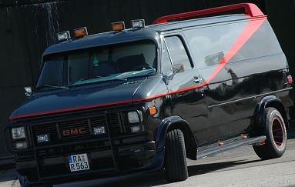
AT: Digital Communications & life skills get you where You want to go
ADA 1990 guarantees equal opportunity to public accommodations including adjustment to a job (ldfra.org)
Cloud: Roof/Researching
Local: Visor/Personal Skills
Hybrid: Lip/Budgeting
The education of children with disabilities can be made more effective by supporting the development and use of technology, including assistive technology
SEC.601.Short Title;Table of Contents; Findings; Purposes. 20 USC 1400. P.L. 108-446, Dec. 3, 2004

Slide 8

Thank You
Twitter
@jollybrailler
@C_TVI
online
Spedjourney.com

Slide 9
Reference page
Action, L. D. (n.d.). LD Resources. Retrieved from LDRFA.org: https://www.ldrfa.org/what-parents-should-know-about-assistive-technology-laws-and-legislation/
Bugaj, C. (2018). The new assistive tech: Make learning awesome for all! Portland, OR: International Society for Technology in Education.
Equillo Jr., A. (n.d.). Megaphoniacs 01, 2015. Fiberglass, reinforced Resin, Oil and Acrylic, with Speakers and Amplifiers. IloIlo Musuem of Contemporary Art, IloIlo, Philippines.
U.S. Department of Education. (2005). ED.gov/Expenditures for Elementary and Secondary Education. Retrieved from Return to No Child Left Behind: Expanding the Promise: https://www2.ed.gov/about/overview/budget/budget06/nclb/edlite-expanding-promise.html

